Slide 1
LBs
File created on: 5/8/2019 11:41:06 AM

Slide 2
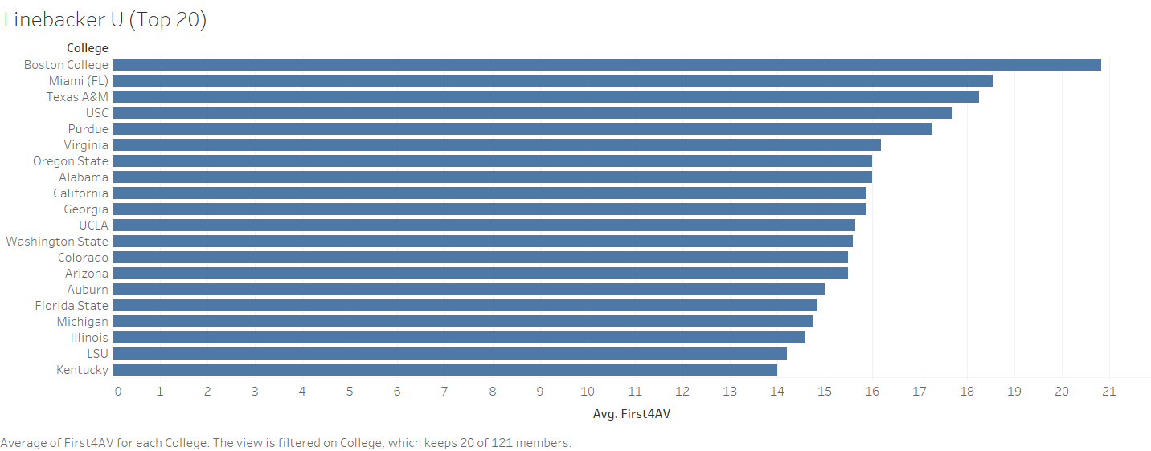

Slide 3
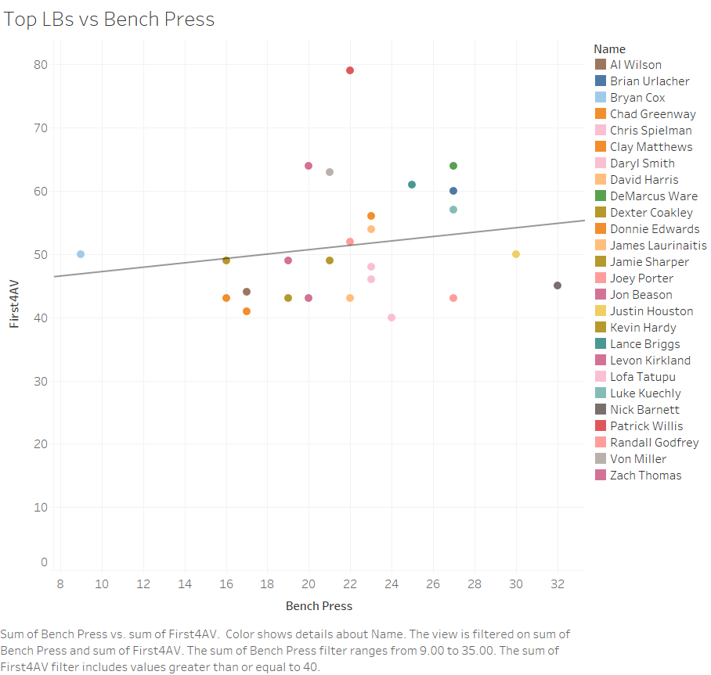

Slide 4
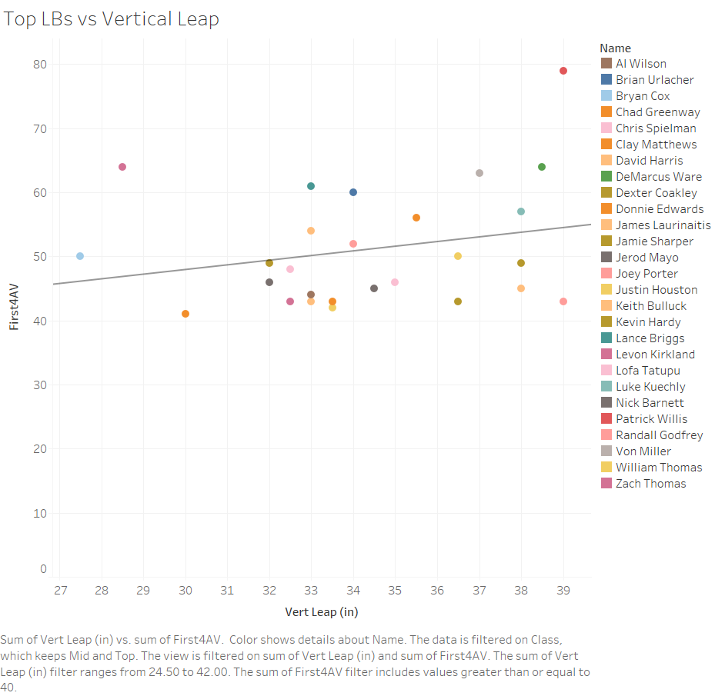

Slide 5
